Slide 1
Asynchronous Code

Slide 2
A developer, we all want to develop good software or good application. We also know that good software is one that is Testable, Maintainable, Reusable, Flexible, and Efficient. Now, we are going to focus on the efficiency aspect. When we talk about efficiency. Concurrency means doing several things at the same time.
This concept of having a Set of Tasks and dividing them into several parts and those several parts can be performed simultaneously is called Parallelism.
In Programming, we can achieve Parallelism by using threads. A thread is a sequence of instructions that can be executed independently of other code. Since they are independent within a process, so we can have several threads. And if our processor allows, then we can run several threads simultaneously. When we are executing multiple threads simultaneously, then it is called multithreading. So, Parallelism uses multiple threads to perform multiple tasks simultaneously.
However, there are other ways to do concurrency. We just talk about efficiency and we associate it with speed. Efficiency also has to do with Resource use. For example, if we have a web server, we want to serve as many web requests as we can concurrently. For that, we need to release threads when they are not in use. We can do this by using Asynchronous Programming.

Slide 3
Asynchronous Programming
Asynchronous Programming allows us to use threads efficiently and threads are prevented from being unnecessarily blocked.
suppose you ordered a pizza using any food delivery app and they tell you it will take 30 minutes to deliver the pizza to your location. What will you do in those 30 minutes? Do you just freeze yourself waiting for the pizza, or will you do some other tasks while the pizza arrives? So, obviously, you want to do a few things while waiting for the pizza.
To work with asynchronous programming in C# we use async and await keywords. The idea is that we need to use the async keyword to mark a method as asynchronous and with await, we can wait for an asynchronous operation in such a way that the original thread is not blocked.
The method which is marked with the async keyword must return a Task or Task<T>. The idea of a Task is that it represents an asynchronous operation and does not return anything. In the case of Task<T>, it is like a promise that in the future this method will return a value of the data type T.

Slide 4
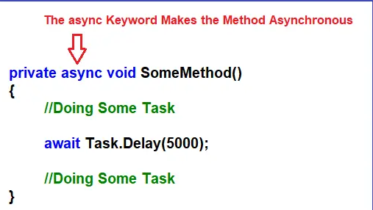
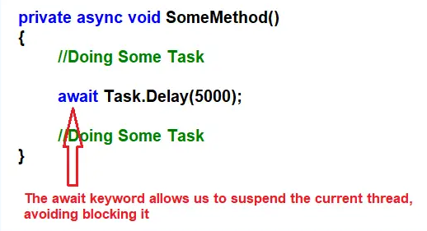
Async Await
So, when we use await operator, what we are doing is, we are freeing the current thread from having to wait for the execution of the task. In this way, we are avoiding blocking the current thread that we’re using and then that thread can be used in another task.

Slide 5
Task
What is the difference between Task and Task<T> in C#?
Although we use both of them i.e. Task and Task<T> in C# for the return data type of an asynchronous method, the difference is that the Task is for methods that do not return a value while the Task<T> is for methods that do return a value of type T where T can be of any data type, such as a string, an integer, and a class, etc. We know from basic C# that a method that does not return a value is marked with a void. This is something to avoid in asynchronous methods. So, don’t use async void except for event h

Slide 6
Newtonsoft.Json
Newtonsoft.Json provides the JsonConvert class, which includes methods for both serialization (converting .NET objects to JSON) and deserialization (converting JSON to .NET objects). andlers.

